Slide 1
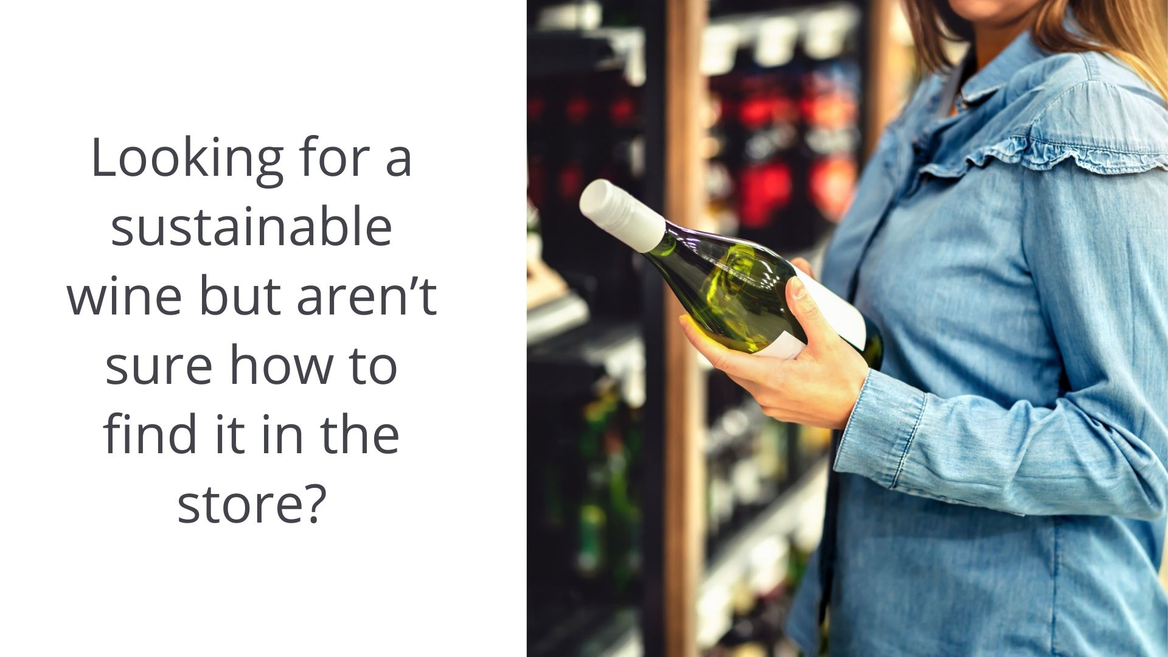

Slide 2
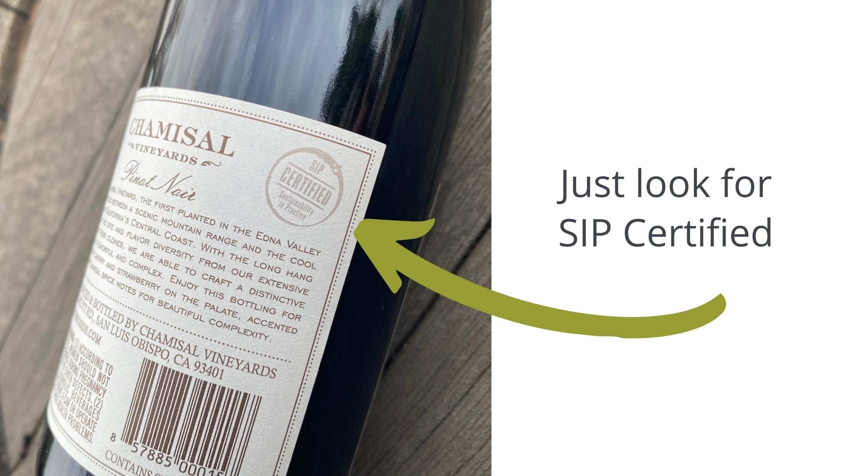

Slide 3
Notes:
-SIP Certified was developed by Vineyard Team, a non-profit dedicated to sustainable winegrowing since 1994
-It evolved from California’s first and award winning sustainable vineyard farming self-assessment
-Vineyard certification Launched in 2008 and because sustainability does not stop in the vineyard, winery certification piloted in 2016
-Certified members must adhere to a strict set of practices that are inspected by third party auditors
-The rules evolve with science and technology through annual updates and external peer review every five years

Slide 4
Notes:
-Sustainability is about being more than green: SIP Certified looks at the 3 P’s – People, Planet, Prosperity

Slide 5
Notes:
(customize with examples from you own property)
-People are our most valuable resource and we take care of them by offering competitive wages, medical insurance, training, and education
-And we give back to our greater comminutes through scholarships, education, and donations

Slide 6
Notes:
(customize with examples from you own property)
-Some of the most visual examples of sustainability protect our planet
-We preserve natural habitat and create wildlife corridors so animals can move freely to watering holes
-We plant soil enriching cover crops to prevent erosion, filter water, provide nutrients to the vines and establish a habitat for beneficial insects
-We filter water for reuse in irrigation
-We use alternative energy like solar and wind
-We employ barn owns as natural gopher getters

Slide 7
Notes:
(customize with examples from you own property)
In order to continue caring for the people and planet, we need to create a prosperous business with ethical practices; by treating employees and the community with care

Slide 8
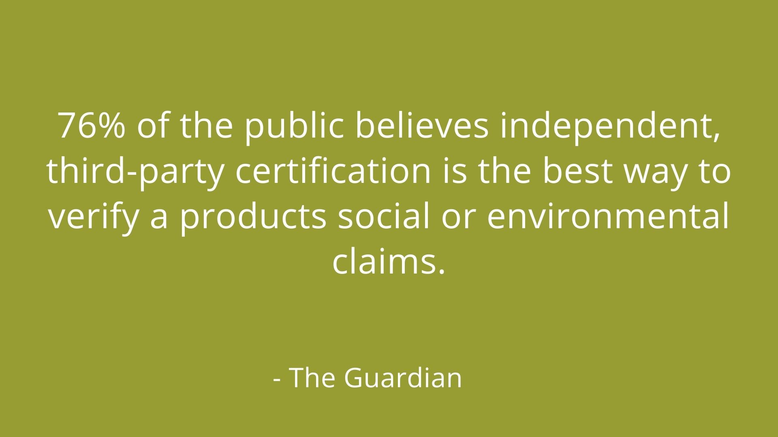
Notes:
-Consumers want to know how their wine is made so SIP Certified developed a program to ensure that the people and the planet are protected. So, when you buy a bottle of SIP Certified wine you know it has been made sustainably.

Slide 9
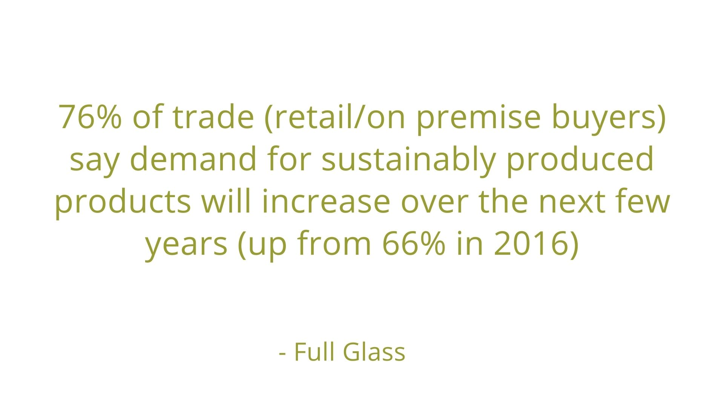
Notes:
As wines make their way through distribution channels, your brand ethos can get lost in the shuffle of distributor portfolios, on premise lists, and supermarket shelves. Full Glass research recently conducted a survey of over 4,700 people in the trade (e.g. sales representatives, store owners, distributors) and found that sustainable messaging helps drive sales as consumers are increasingly aware of and demanding sustainable wines. The research found that making your certification visible on the bottle and on marketing materials aids in sales.

Slide 11
Add a quote about why sustainability is important to your company.
Notes:
Add your own quote about why SIP Certified is important to your brand.

Slide 12
